Slide 1

Game Theory in Wireless and Communication Networks: Theory, Models, and Applications
Lecture 2
Bayesian Games
Zhu Han, Dusit Niyato, Walid Saad,
Tamer Basar, and Are Hjorungnes

Slide 2
Overview of Lecture Notes
Introduction to Game Theory: Lecture 1, book 1
Non-cooperative Games: Lecture 1, Chapter 3, book 1
Bayesian Games: Lecture 2, Chapter 4, book 1
Differential Games: Lecture 3, Chapter 5, book 1
Evolutionary Games: Lecture 4, Chapter 6, book 1
Cooperative Games: Lecture 5, Chapter 7, book 1
Auction Theory: Lecture 6, Chapter 8, book 1
Matching Game: Lecture 7, book 2
Contract Theory, Lecture 8, book 2
Stochastic Game, Lecture 9, book 2
Learning in Game, Lecture 10, book 2
Equilibrium Programming with Equilibrium Constraint, Lecture 11, book 2
Mean Field Game, Lecture 12, book 2
Zero Determinant Strategy, Lecture 13, book 2
Network Economy, Lecture 14, book 2
Game in Machine Learning, Lecture 15, book 2
[<number>]

Slide 3
Overview of Bayesian Game
Static Bayesian Games
Bayesian Dynamic Games in Extensive Form
Detailed Example: Cournot Duopoly Model with Incomplete Information
Applications in Wireless Networks
  Packet Forwarding
  K-Player Bayesian Water-filling
  Channel Access
  Bandwidth Auction
Summary
[<number>]

Slide 4
What is Bayesian Game?
Game in Strategic Form
  Complete Information: Each player has complete information regarding the elements of the game
  Dominant Strategy: Iterated deletion of other strategies
  Nash Equilibrium: Solution of the game in strategic form
Bayesian Game
  A game with incomplete information
  Each player has initial private information, type
  Bayesian Equilibrium: Solution of the Bayesian game
[<number>]

Slide 5








Bayesian Game
Definition
A Bayesian game is a strategic form game with incomplete information. It consists of:
- A set of players, N={1, …, n}; for each i ∈ N,
- An action set,
- A type set,
- A probability function,
- A payoff function,
- The function is player i’s belief about the types of the other players
- Payoff of player i, is defined as a function of action, and type,
- Belief formulation captures the uncertainty on the payoffs of other players
[<number>]

Slide 6





Bayesian Game
Definition
Bayesian game is finite if , , and are all finite
Definition (Pure strategy, Mixed strategy)
Given a Bayesian Game , a pure strategy for player i is a function which maps player i’s type into its action set
A mixed strategy for player i is
[<number>]

Slide 7


Bayesian Equilibrium
Definition
A Bayesian equilibrium of a Bayesian game is a mixed strategy profile , such that for every player i ∈ N and every type , we have
- Bayesian equilibrium is one of the mixed strategy profiles which maximizes each players’ expected payoff for each type.
This equilibrium is the solution for the Bayesian game. This equilibrium is the best response to each player’s belief about the other player’s mixed strategy.
[<number>]

Slide 8
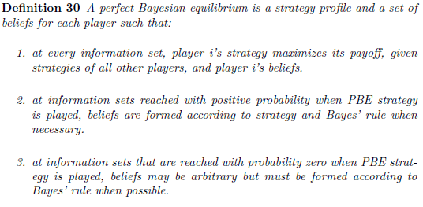
Bayesian Dynamic Game
Bayesian equilibrium results in complicated equilibria in dynamic game
Refinement schemes do not always work in incomplete information
Hence, perfect Bayesian equilibrium (demands optimal subsequent play)
[<number>]

Slide 9
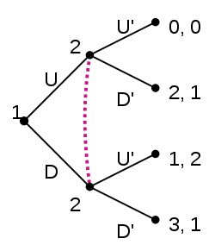
Simple Example
Information is imperfect since player 2 does not know what player 1 does when he comes to play.
If both players are rational and both know that too, play in the game will be as follows according to perfect Bayesian equilibrium:
Player 1 likes to fool player 2 into thinking he has played U, when he has actually played D, so that player 2 will play D' and player 1 will receive 3.
In fact, there is a perfect Bayesian equilibrium where player 1 plays D and player 2 plays U' and player 2 holds the belief that player 1 will definitely play D (i.e player 2 places a probability of 1 on the node reached if player 1 plays D).
In this equilibrium, every strategy is rational given the beliefs held and every belief is consistent with the strategies played. In this case, the perfect Bayesian equilibrium is the only Nash equilibrium.
Player 2 cannot observe player 1's move
[<number>]

Slide 10
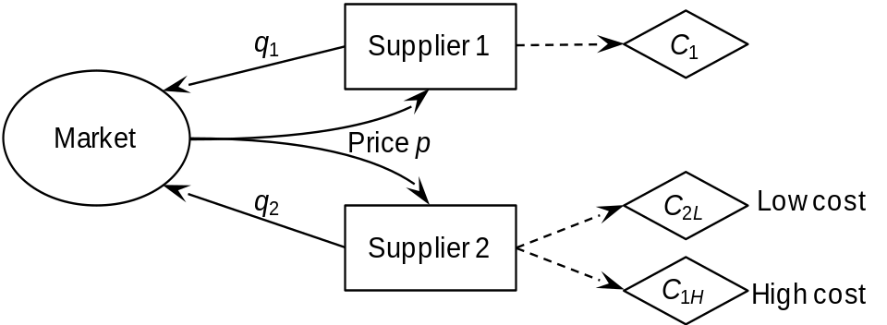



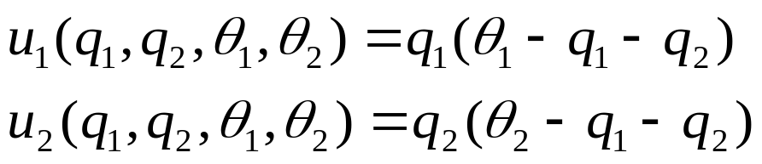
Example: Cournot Duopoly
Cournot duopoly model
Players (2 firms):
Action set (outcome of firms):
Type set:
Probability function:
Profit function:
[<number>]

Slide 11
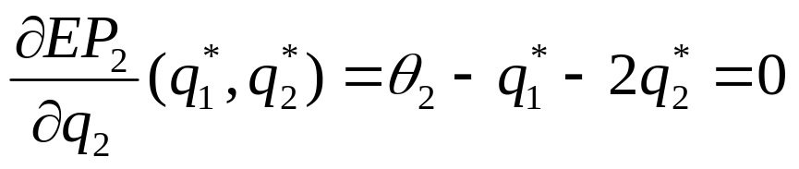

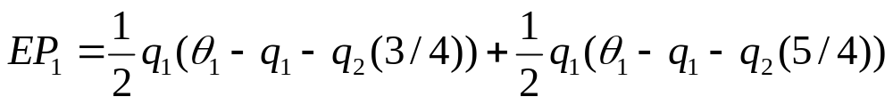
Example: Cournot Duopoly
Bayesian equilibrium for pure strategy:
The Bayesian equilibrium is a maximal point of expected payoff of firm 2, EP₂:
- The expected payoff of firm 1, EP₁, is given as follows:
[<number>]

Slide 12
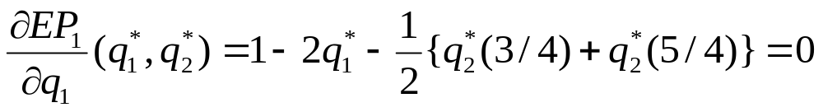
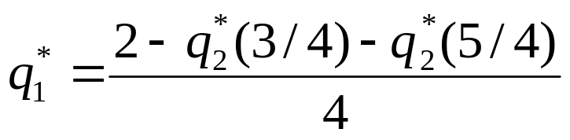
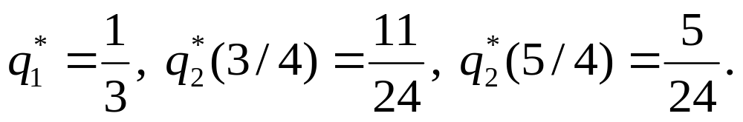
Example: Cournot Duopoly
- Bayesian equilibrium is also the maximal point of expected payoff, EP₁:
- Solving the above equations, we can get Bayesian equilibrium as follows:
[<number>]

Slide 13
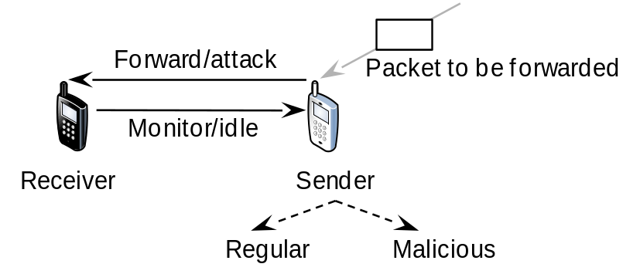


Example: Packet Forwarding
System model; Pure strategy
  Sender type: Malicious or regular
  Payoff: Malicious vs. regular
  Malicious sender: C_{A}- Cost of attack, G_{A}- Attack success
  Regular sender: C_{F}- Cost of forwarding
  Receiver: C_{M}- Cost of monitoring, -G_{A}- Cost of being attacked
Mixed strategy
  Malicious sender: Attack with a certain probability
  Regular sender: Forward packet
  Receiver: Monitor with a certain probability
[<number>]

Slide 14

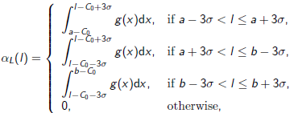

Example: K-Player Bayesian Water-filling
System model
  R: Rate; P: Power; h: Channel gain
A user knows the exact value of its own channel gain only
  Channel gains of others are random variables, e.g. Shadow fading
Path loss probability density function (belief of the other users)
The best response of user i
[<number>]

Slide 15

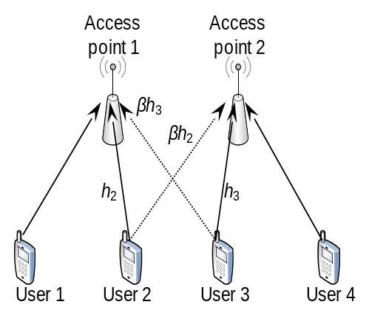



Example: Channel Access
System model
  Bayesian since do not know the other’s channel (or type)
  Transmission success
  Throughput
  Utility
  Bayesian NE
Threshold strategy
  Interpretation of opportunistic spectrum access from the game theory point of view
Interference among transmissions
[<number>]

Slide 16

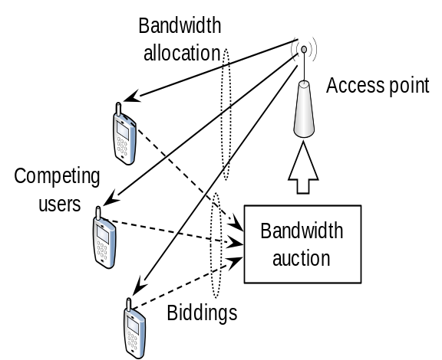


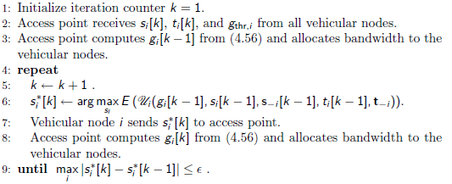
Example: Bandwidth Auction
System model
  Allocated bandwidth
  s_{i} - Bid, B - Total bandwidth, t_{i} - Time duration
  of connection, U - utility
  Pdf of t_{i} of other nodes
  Bayesian NE
Iterative algorithm to obtain Bayesian NE
[<number>]

Slide 17
Summary
Games with incomplete information (i.e., Bayesian game) can be used to analyze situations where a player does not know the preference (i.e., payoff) of his opponents.
This is a common situation in wireless communications and networking where there is no centralized controller to maintain the information of all users. Also, the users may not reveal the private information to others.
The details of the Bayesian game framework were studied.
Some applications of the Bayesian game framework in wireless communications and networking were discussed.
[<number>]

